Slide 1
Introduction to Data Preprocessing
Definition: Preparing raw data for machine learning models.
Data
Cleaning
Data Transformation
Data Integration
Data
Reduction
Removing errors, missing values, and inconsistencies.
Converting data into a suitable format.
Combining data from multiple sources.
Simplifying data while retaining important information.

Slide 2
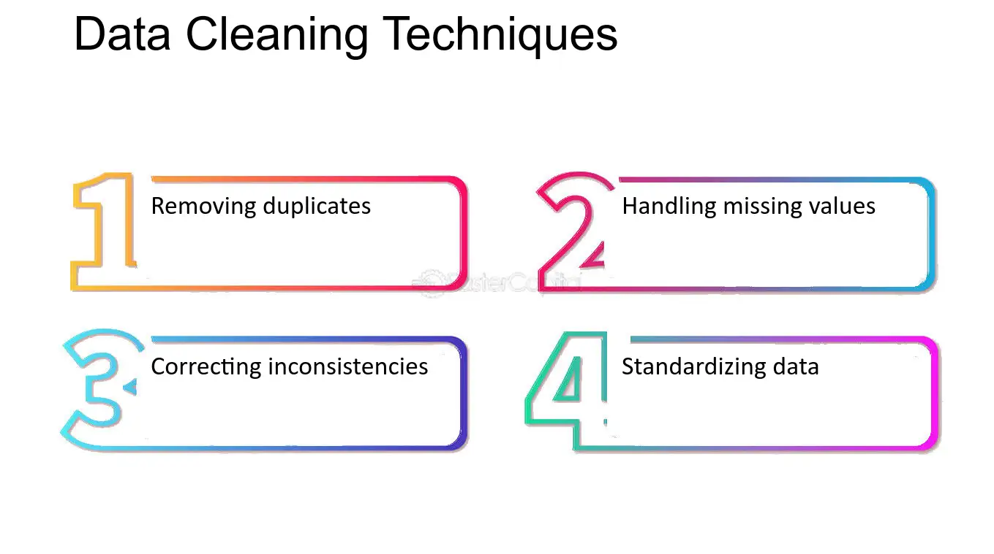
Data Cleaning
What is Data Cleaning?
Process of detecting and correcting errors in the dataset
Steps: Handling missing values, dealing with outliers, removing duplicates

Slide 3
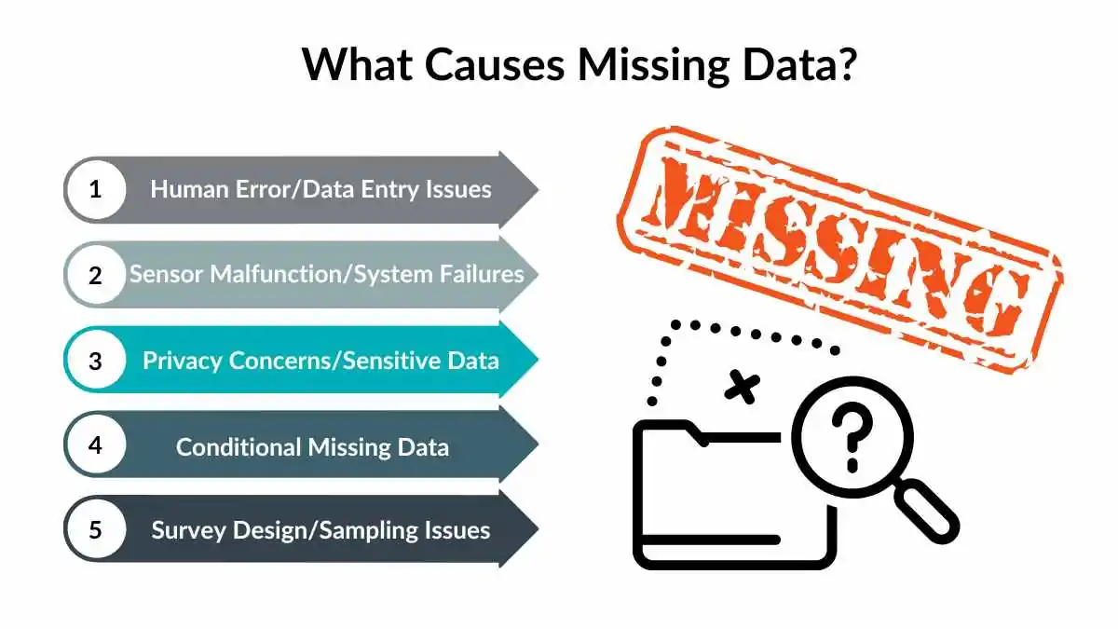
Handling Missing Values
Why missing values occur? (Human error, sensor failure, etc.)

Slide 4
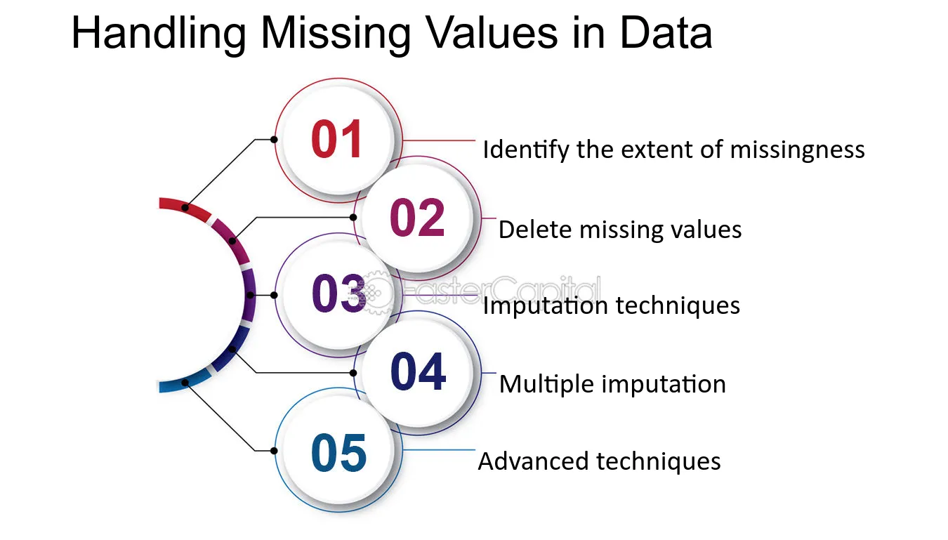
Handling Missing Values
Techniques to handle missing data:
Removing missing values
Mean/median/mode imputation
Predictive imputation (KNN, regression-based imputation)

Slide 5
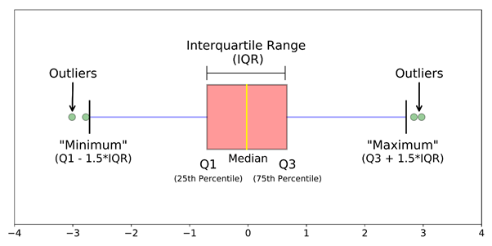
Handling Outliers
Definition: Data points that significantly differ from others

Slide 6
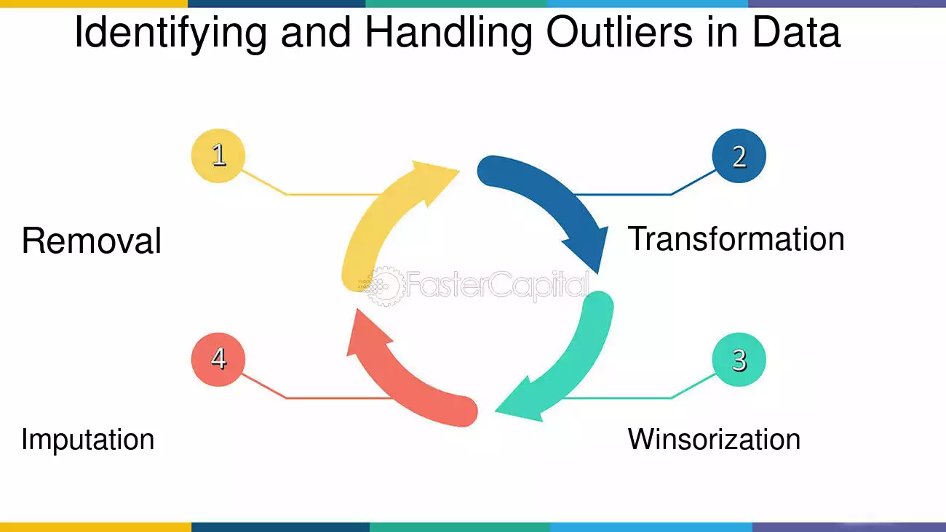
Handling Outliers
Techniques to handle outliers:
Z-score method: Detects outliers using standard deviations.
IQR method: Identifies outliers using quartiles and interquartile range.
Winsorization: Limits extreme values to reduce impact.
Removing based on business logic: Eliminates unrealistic or irrelevant data points.

Slide 7
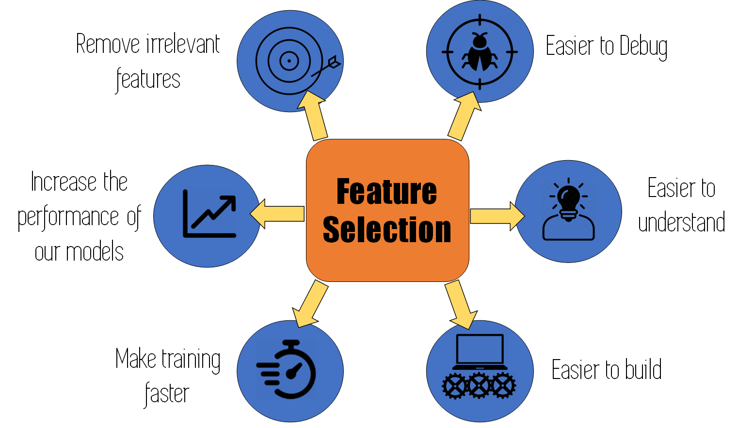
Feature Selection
What is Feature Selection?
Selecting important features to improve model efficiency
Benefits:
Reduces overfitting
Speeds up computation
Enhances model interpretability

Slide 8
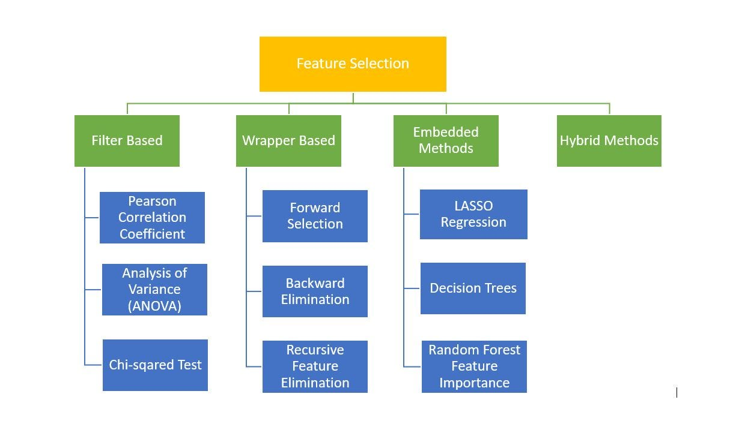
Feature Selection Methods

Slide 9
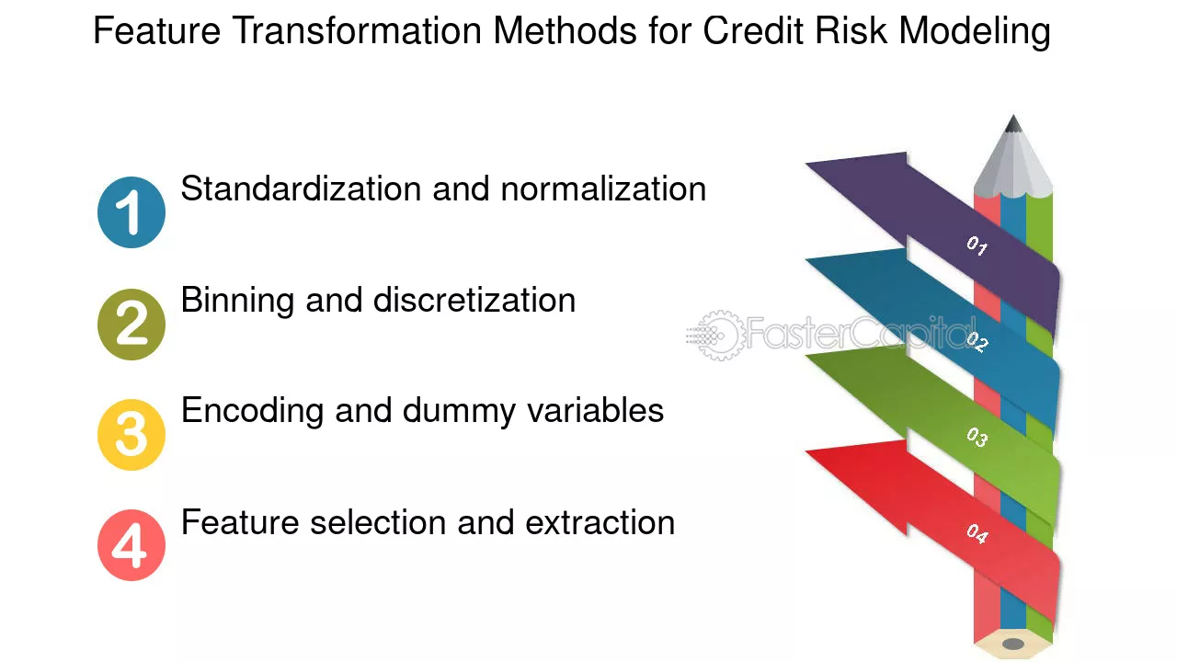
Feature Transformation
What is Feature Transformation?
Modifying data to improve model performance

Slide 10
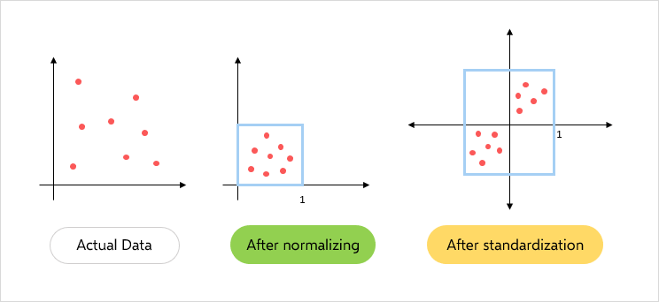
Scaling & Normalization
Scaling (Standardization): Mean = 0, Standard Deviation = 1 (e.g., StandardScaler)
Normalization (Min-Max Scaling): Rescales data to [0,1] (e.g., MinMaxScaler)

Slide 11
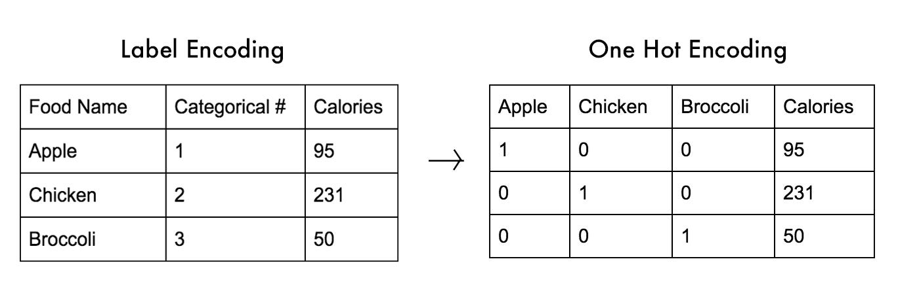
Encoding Categorical Variables
Why encoding is needed? (ML models need numerical input)
Methods: Label Encoding , One-Hot Encoding

Slide 12
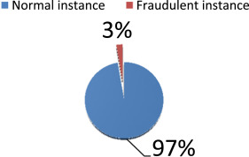
Handling Imbalanced Data
What is Imbalanced Data?
When one class has significantly more samples than another
Example: Fraud detection (97% normal, 3% fraud cases)

Slide 13
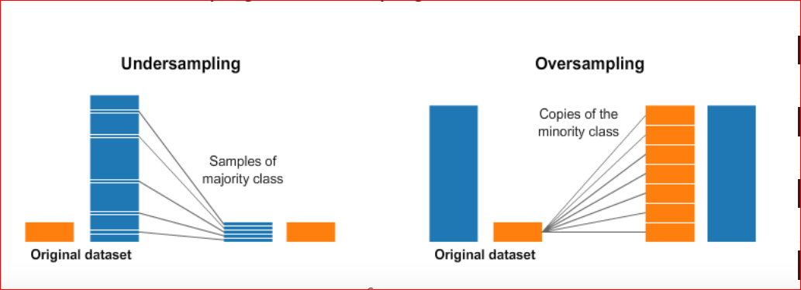
Techniques to Handle Imbalanced Data
Resampling Methods
Oversampling (SMOTE, ADASYN)
Undersampling (Random, Tomek Links)

Slide 14
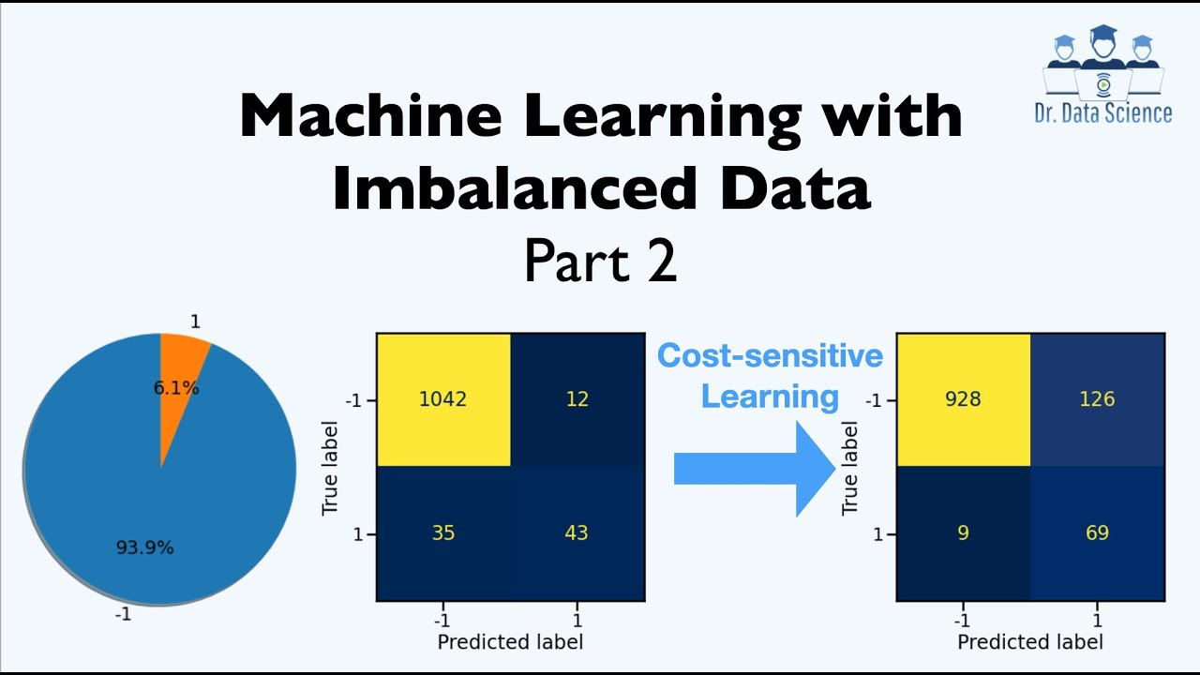
Techniques to Handle Imbalanced Data
Cost-Sensitive Learning
Assigning higher weights to minority class

Slide 15
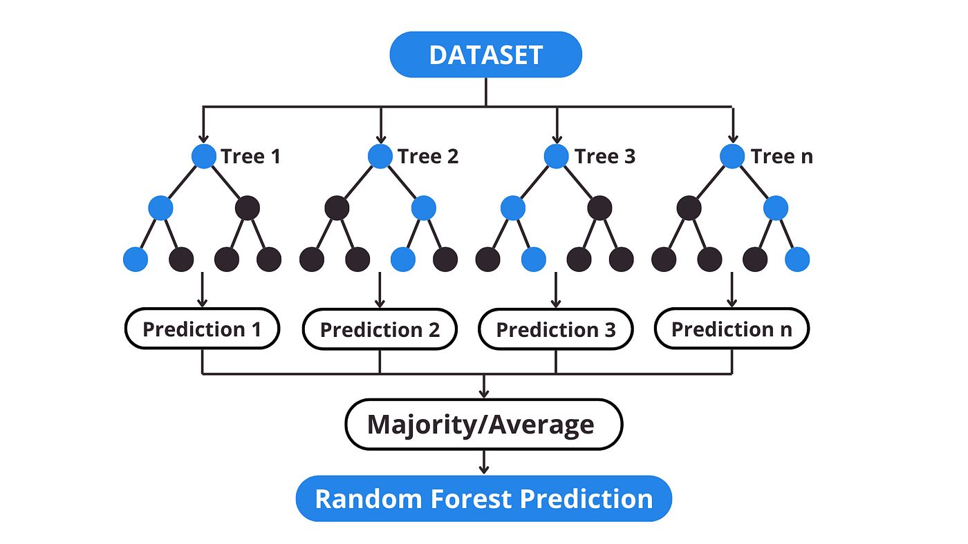
Techniques to Handle Imbalanced Data
Algorithmic Approaches
Tree-based models (Random Forest, XGBoost handle imbalance well)

Slide 16
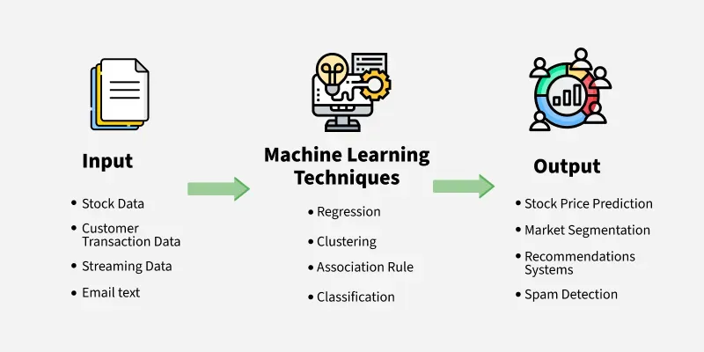
Introduction to Machine Learning
Definition: Machine Learning (ML) is a subset of AI that enables computers to learn patterns from data and make predictions or decisions without explicit programming.

Slide 17
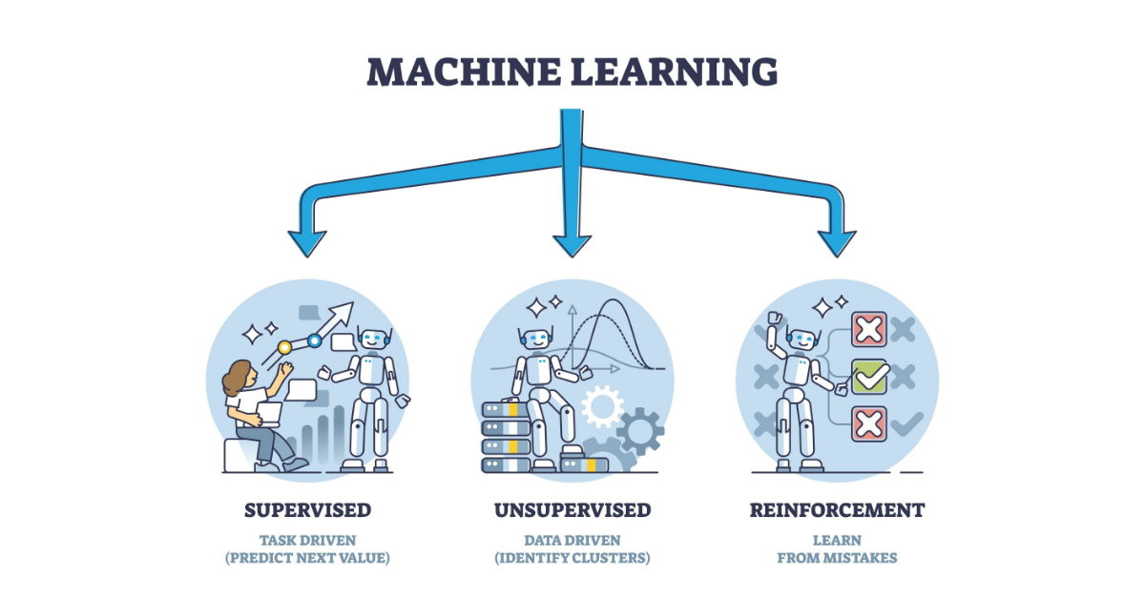
Types of Machine Learning

Slide 18
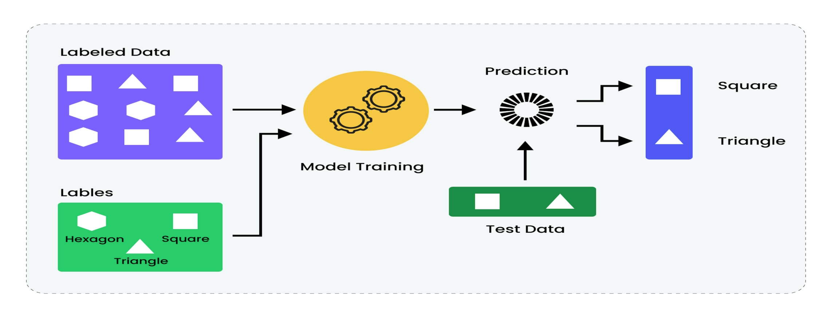
Supervised Learning
What is Supervised Learning?
Learning from labeled data
Examples: Email spam detection, medical diagnosis

Slide 19
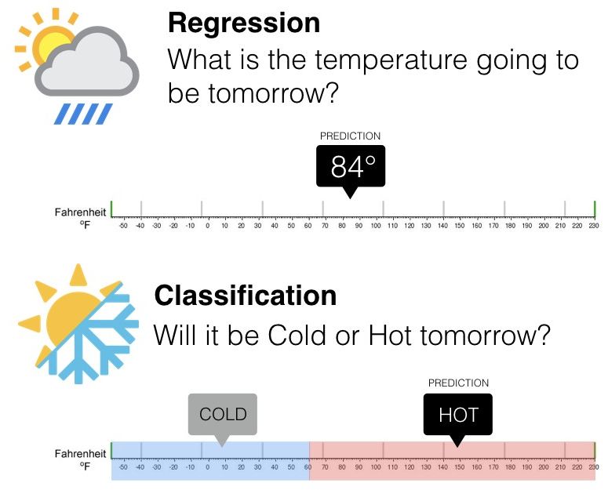
Supervised Learning Tasks

Slide 20
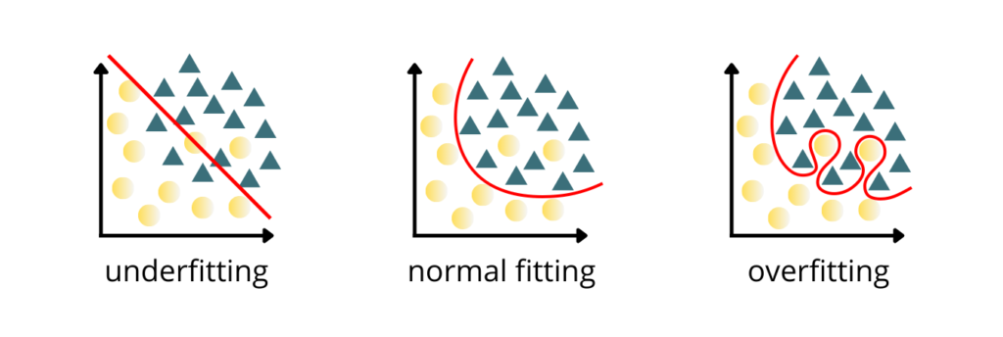
Overfitting in Supervised Learning
Definition: Model learns noise instead of pattern
Solution: Regularization, cross-validation

Slide 21
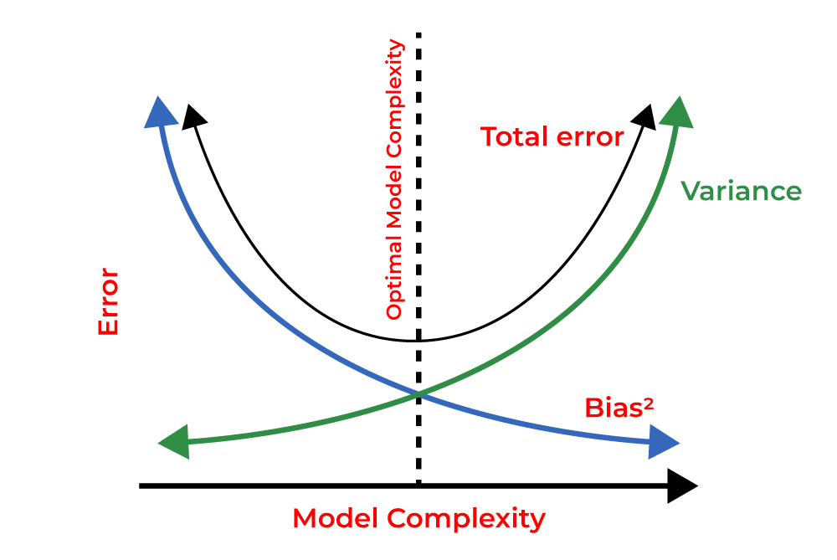
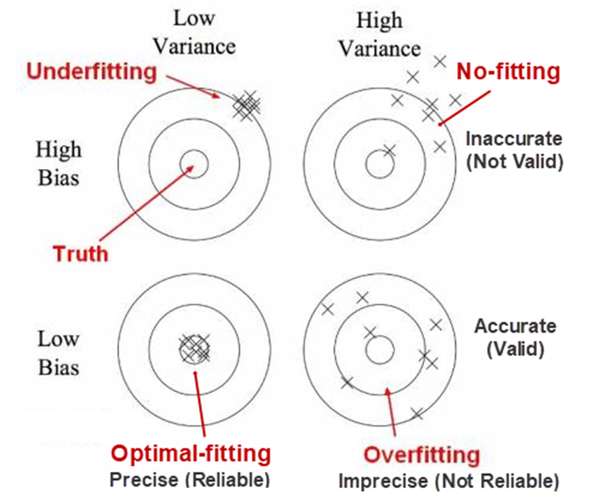
Bias-Variance Trade-off
Bias: Error due to overly simplistic models
Variance: Error due to overly complex models
Trade-off: Balancing both for optimal performance

Slide 22
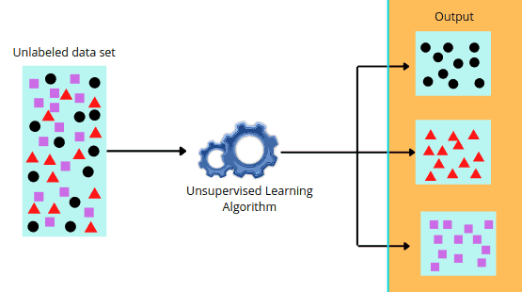
Unsupervised Learning
What is Unsupervised Learning?
Learning from unlabeled data
Examples: Customer segmentation, anomaly detection

Slide 23
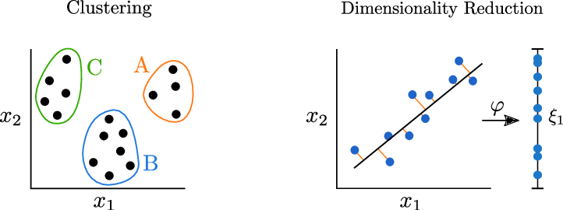
Unsupervised Learning Tasks

Slide 24
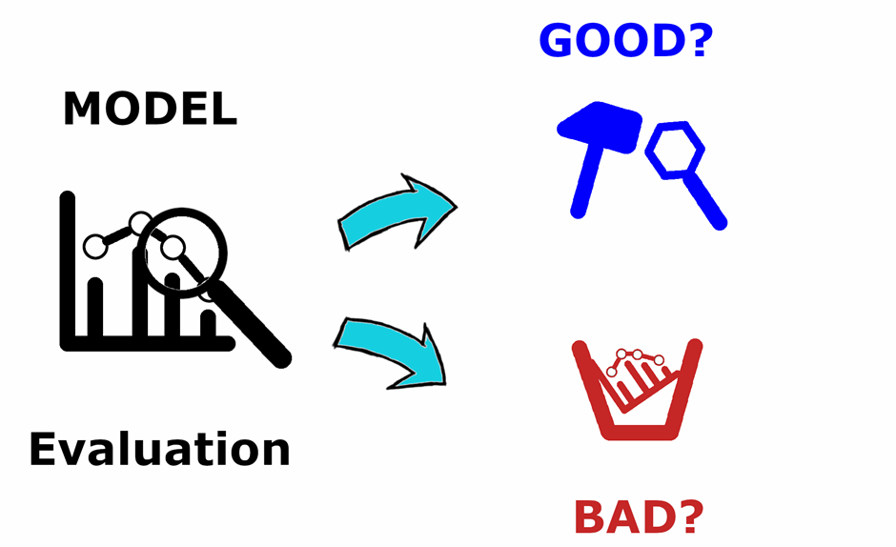
Why Evaluation is Important?
Helps assess the performance of ML models

Slide 25
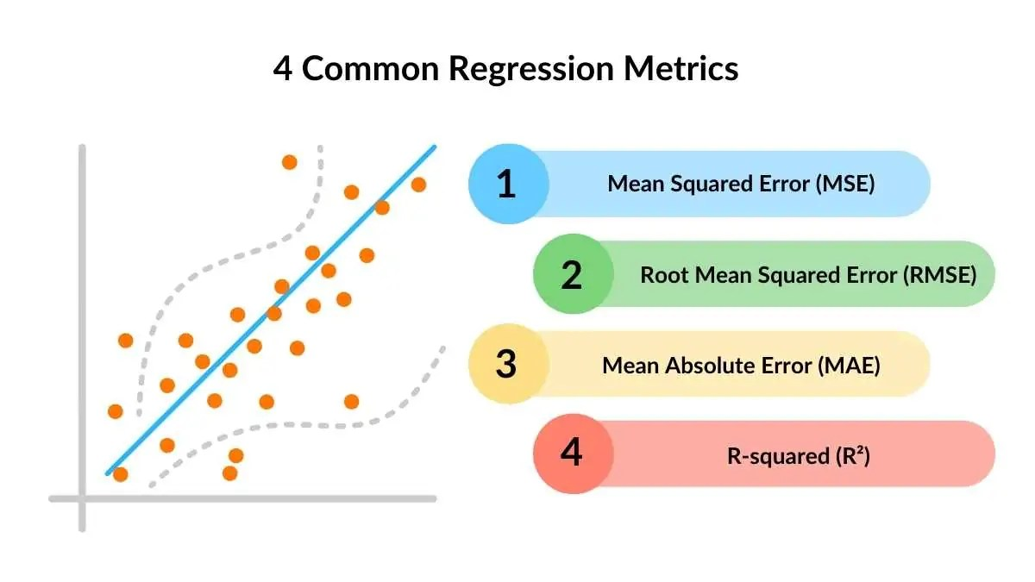
Regression Metrics
MSE Measures average squared error
RMSE Square root of MSE (same unit as target)
MAE Measures average absolute error
R-squared (R²) - Coefficient of Determination : Measures goodness of fit (closer to 1 = better)

Slide 26
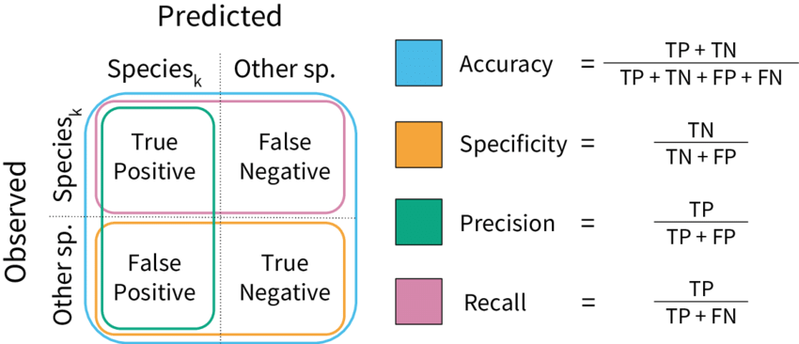
Classification Metrics
Accuracy = (Correct Predictions / Total Predictions)
Precision = (True Positives / (True Positives + False Positives))
Recall = (True Positives / (True Positives + False Negatives))
F1-Score = 2 × (Precision × Recall) / (Precision + Recall)

Slide 27
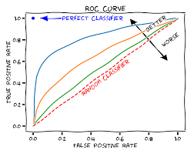
ROC Curve & AUC
ROC Curve: Trade-off between True Positive Rate (TPR) & False Positive Rate (FPR)
AUC (Area Under Curve): Higher AUC = Better model

Slide 28
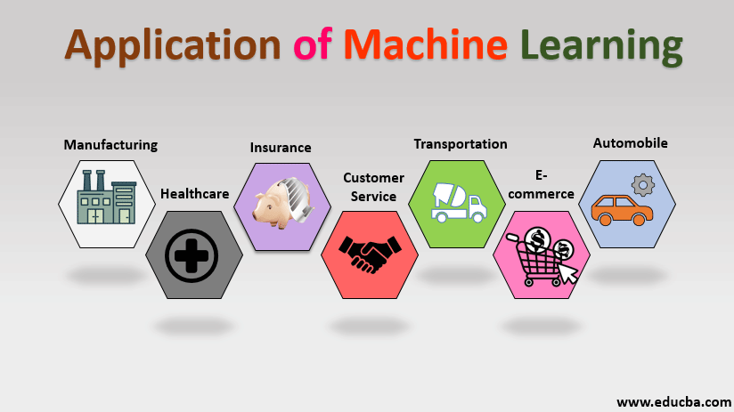
Applications of Machine Learning

Slide 29
Thank You

